Slide 1
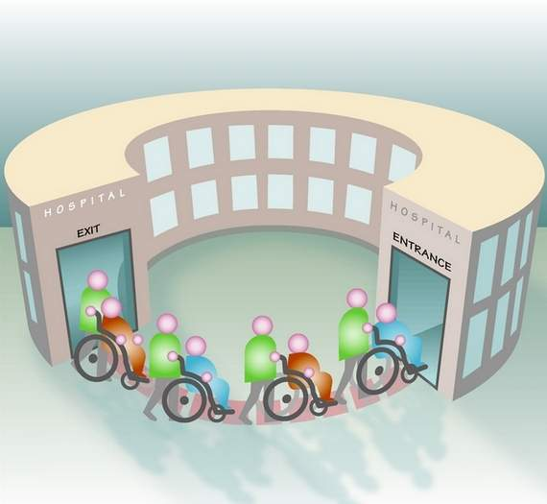
Predicting Risk and Cost of CHF Readmission
Data Mining Course Project, Winter 2015
Professor: Dr. Martine De Cock
Advisor: Shanu sushmita
Group2
Diksha Garg
Stacey Newman
Zeinab Mahdavifar

Slide 2
Overview
Data Investigation
Building Predictive Models + Results
Feature Selection
Future Work

Slide 3
Some fun stats…
Gender Distribution for 3 Cost buckets
Gender Distribution for 3 Risk buckets

Slide 4
Data Statistics: Cost and Risk
Cost | Number of Rows | Age (avg) | Number of Female | Number of Males | LOS | DXCSS1 | PRCCS1
High | 1221 | 67 | 606 | 615 | 5.84 | 108 | 216
Med | 1232 | 68 | 617 | 651 | 5.01 | 108 | 216
Low | 1219 | 70 | 559 | 660 | 4.16 | 108 | 58
Risk
30 | 2476 | 68 | 1176 | 1300 | 5.12 | 108 | 216
60 | 816 | 69 | 401 | 415 | 4.86 | 108 | 58
90 | 380 | 70 | 205 | 175 | 4.55 | 108 | 222

Slide 5
Data Statistics: Cost-Risk
Cost | # of Rows | Age (avg) | Number of Female | Number of Males | LOS | DXCCS1 | PRCSS1
High-30 | 810 | 67 | 421 | 419 | 6.03 | 108 | 216
Med-30 | 826 | 68 | 395 | 431 | 5.09 | 108 | 216
Low-30 | 810 | 69 | 360 | 450 | 4.2 | 108 | 216
High-60 | 261 | 68 | 127 | 134 | 5.64 | 108 | 216
Med-60 | 274 | 69 | 145 | 129 | 4.65 | 108 | 216
Low-60 | 281 | 70 | 129 | 152 | 4.32 | 108 | 58
High-90 | 120 | 68 | 58 | 62 | 4.86 | 108 | 216
Med-90 | 132 | 69 | 77 | 55 | 5.22 | 108 | 216
Low-90 | 128 | 72 | 70 | 58 | 3.56 | 108 | 58

Slide 6

Project Scheme
Majority Baseline
SVM
Naïve Bayes
Decision Tree
Predicted Cost
Predicted Risk
Label Powerset
(Cost+Risk)
DXCCS1, DRG, PRCCS1, AGE, RACE, FEMALE, NCHRONIC, LOS, TOTCHG, CostLabel, RiskLabel
11-Feature
Preprocessed
CHF Data
Predictive Models
Results

Slide 7
Results – Predicting Cost
All results validated by 10-fold cross validation
ML Algorithm |  | Average Accuracy | Average Precision | Average Recall | F1-Measure
Majority Baseline |  | 0.335512 | 0.111837 | 0.333333 | 0.167756
Naïve Bayes |  | 0.381264 | 0.399797 | 0.382338 | 0.390873
SVM |  | 0.433279 | 0.424843 | 0.433893 | 0.429320
Decision Tree | 0.01* | 0.441449 | 0.428879 | 0.442223 | 0.435449
 | 0.001 | 0.431100 | 0.427152 | 0.431496 | 0.429313
 | 0.0005 | 0.409314 | 0.408536 | 0.409518 | 0.409026
* Complexity Parameters

Slide 8
Confusion Matrix – Best Model Predicting Cost (Decision Tree 0.01)
 | High | Medium | Low
High (prediction) | 704 | 576 | 347
Medium (prediction) | 239 | 250 | 205
Low (prediction) | 278 | 406 | 667

Slide 9
Results – Predicting Risk
All results validated by 10-fold cross validation
ML Algorithm |  | Average Accuracy | Average Precision | Average Recall | F1-Measure
Majority Baseline |  | 0.674292 | 0.224764 | 0.333333 | 0.268488
Naïve Bayes |  | 0.665850 | 0.328383 | 0.333421 | 0.330883
SVM |  | 0.674020 | 0.224734 | 0.333199 | 0.268424
Decision Tree | 0.01* | 0.674292 | 0.224764 | 0.333333 | 0.268488
 | 0.001 | 0.641612 | 0.294261 | 0.330598 | 0.311372
 | 0.0005 | 0.590142 | 0.315585 | 0.326668 | 0.321031
* Complexity Parameters

Slide 10
Confusion Matrix – Best Model Predicting Risk (Decision Tree 0.01)
 | 30 day | 60 day | 90 day
30 day (prediction) | 2476 | 816 | 380
60 day (prediction) | 0 | 0 | 0
90 day (prediction) | 0 | 0 | 0

Slide 11
Results – Label Powerset (Cost + Risk)
All results validated by 10-fold cross validation
ML Algorithm |  | Average Accuracy | Average Precision | Average Recall | F1-Measure
Majority Baseline |  | 0.228758 | 0.025418 | 0.111111 | 0.041371
Naïve Bayes |  | 0.238290 | 0.114896 | 0.126197 | 0.120282
SVM |  | 0.292484 | 0.095958 | 0.144882 | 0.115451
Decision Tree | 0.01* | 0.303105 | 0.068128 | 0.149442 | 0.093590
 | 0.001 | 0.292484 | 0.151826 | 0.148170 | 0.149975
 | 0.0005 | 0.265795 | 0.130312 | 0.139995 | 0.134980
* Complexity Parameters

Slide 12
Confusion Matrix – Best Model Predicting Cost + Risk (Decision Tree 0.01)
 | High 30 day | High 60 day | High 90 day | Medium 30 day | Medium 60 day | Medium 90 day | Low 30 day | Low 60 day | Low 90 day
High 30 day | 660 | 190 | 85 | 535 | 177 | 88 | 357 | 122 | 49
High 60 day | 0 | 0 | 0 | 0 | 0 | 0 | 0 | 0 | 0
High 90 day | 0 | 0 | 0 | 0 | 0 | 0 | 0 | 0 | 0
Med 30 day | 0 | 0 | 0 | 0 | 0 | 0 | 0 | 0 | 0
Med 60 day | 0 | 0 | 0 | 0 | 0 | 0 | 0 | 0 | 0
Med 90 day | 0 | 0 | 0 | 0 | 0 | 0 | 0 | 0 | 0
Low 30 day | 180 | 71 | 35 | 291 | 97 | 44 | 453 | 159 | 79
Low 60 day | 0 | 0 | 0 | 0 | 0 | 0 | 0 | 0 | 0
Low 90 day | 0 | 0 | 0 | 0 | 0 | 0 | 0 | 0 | 0

Slide 13
Comparing Accuracy

Slide 14
Feature Selection – Cost Prediction

Slide 15
Feature Selection – Risk Prediction

Slide 16
Feature Selection- Risk-Cost Prediction

Slide 17
Feature Selection
Measure | Cost Prediction | Risk Prediction
cfs | DX1 + DX2 + DX3 + DX4 + DX5 + DX6 + DX7 + DX12 + DX16 + DX19 + DX21 + DX22 + DX23 + DX25 +ECODE2 + PL_RUCC2003 + PSTCO2 + TOTCHG + TOTCHG_X + ZIP3 + ZIP + CumulativeCost | DISPUB04 + DQTR + DX1 + DX2 + DX4 + DX6 + DX7 + DX9 + DX11 + DX12 + DX16 + DX18 + DX21 + DX22 + DX23 + DX24 + DX25 + ECODE2
Information gain+ cutoff | DX5 + DX7 + DX6 + DX4 + DX10 + DX3 + DX8 + DX9 + DX12 + DX11 + DX2 + DX13 + DX14 + DX1 + DX15 + DX16 + DX17 + DSHOSPID + DX18 + DX19 | DX6 + DX7 + DX9 + DX11 + DX8 + DX4 + DX5 + DX10 + DX12 + DX3 + DX14 + DX2 + DX13 + DX1 + DX15 + DX16 + DX17 + DX18 +DX19 + DX20 + DX21 + DX22 + DX23 + DSHOSPID + DX24 + DX25 + ECODE1
symmetrical uncertainty | DX19 + DX16 + DX18 + DX21 + DX5 + DX20 + DX12 + DX15 + DX22 + DX17 + DX14 + DX7 + DX6 + DX10 + DX4 + DX13 + DX3 + DX11 + DX23 + DX2 + DX9 + DX8 + DX1 + DX24 | DX21 + DX22 + DX23 + DX20 + DX18 +DX17 + DX19 + DX16 + DX11 + DX14 + DX15 + DX12 + DX6 + DX9 + DX24 + DX7 + DX4 + DX10 + DX8 + DX1 + DX5 + DX13 + DX3 + DX2 + DX25

Slide 18

Future Work
Majority Baseline
Random Baseline
SVM
Naïve Bayes
Decision Tree
Predicted Cost
Predicted Risk
(MultiLabel Results)
Predicted Risk-Cost
(Label Powerset)
Predicted Risk-Cost
(Chained Classification)
Chi Square
Mutual Information
Caret
FSelector
Full
Feature set
250-Feature
Preprocessed
CHF Data
Feature Selection
Predictive Models
Results

Slide 19


Questions…
Predicted Cost
Predicted Risk
(MultiLabel Results)
Predicted Risk-Cost
(Label Powerset)
Predicted Risk-Cost
(Chained Classification)
Chi Square
Mutual Information
Caret
FSelector
Majority Baseline
Random Baseline
SVM
Naïve Bayes
Decision Tree
Full
Feature set
250-Feature
Preprocessed
CHF Data
Feature Selection
Predictive Models
Results
19

Slide 20

Appendix 1 Evaluation & Validation
Evaluation Metrics
Validation
Accuracy | Precision | Recall | F-1 measure
A=TP+TN/(TP+FP+FN+TN) | P = TP / ( TP + FP ) | R = TP/ (TP + FN ) | F₁= 2PR / ( P + R )
10-fold Cross Validation
In k-fold cross-validation, the original sample is randomly partitioned into k equal size subsamples. Of the k subsamples, a single subsample is retained as the validation data for testing the model, and the remaining k − 1 subsamples are used as training data. The cross-validation process is then repeated k times (the folds), with each of the k subsamples used exactly once as the validation data. The k results from the folds can then be averaged (or otherwise combined) to produce a single estimation. The advantage of this method over repeated random sub-sampling (see below) is that all observations are used for both training and validation, and each observation is used for validation exactly once.

Slide 21
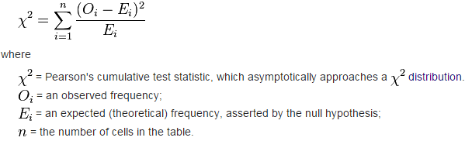

Appendix 2 Similarity Measures
CHI-Square Measure | Mutual Information Measure

